Slide 1
CS4499/5599: Data Science and Applied Machine Learning
Class Lecture: February 15th, 2023

Slide 2
Objectives
Last time:
Correlation
Statistical Hypothesis Testing
P-Value
Today:
Finish P-Values
Linear Regression

Slide 3
Variable Relationships
On of the major goals in data science is to discover the relationship between different variables
The reason for this is many of the areas where data science is applied are interested in how different variables relate to one another
In business, an analyst can use this information to predict:
Sales
Prices
Salaries

Slide 4
Variable Relationships
Other fields also have interest in using variable relationships to gain value
For example, in medicine a doctor can analysis the effect of a treatment based on medical history
Environmental scientist are interested in using pollution data to compare against temperature
Material scientist commonly want to know the relationship between external forces and material behavior

Slide 5
Regression Analysis
A common form of examining variable relationship is regression analysis
Regression analysis seeks to describe the relationship a dependent variable and one or more independent variables
Most often regression analysis begins with a single variable, known as linear regression
However, there are several types of regression that can be applied

Slide 6
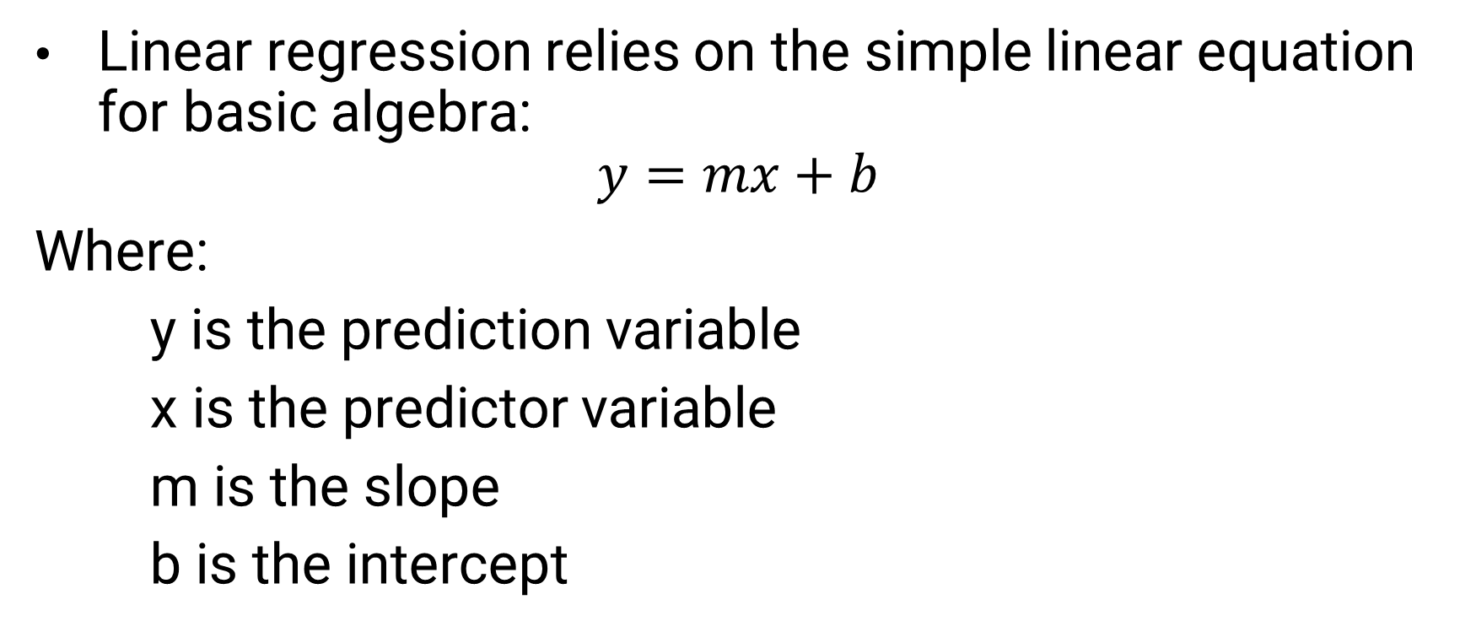
Linear Regression
Linear regression relies on the simple linear equation for basic algebra:
$$y=mx+b$$
Where:
y is the prediction variable
x is the predictor variable
m is the slope
b is the intercept

Slide 7
Linear Regression
Let’s consider a basic problem for all university students, how many hours to study for an exam
What do you think our predictor and prediction should be for this problem?
Hours to study
Test scores
We can easily create a linear model to describe the relationship between these variables

Slide 8
Linear Regression
Of course, we know our model is not exact (otherwise school would be much easier)
There are several other factors that influence our testing performance
We can account for this in our model by adding an error factor
If the error factor is small the predictions could still be useful, however, if our error is large the value of our model decreases

Slide 9
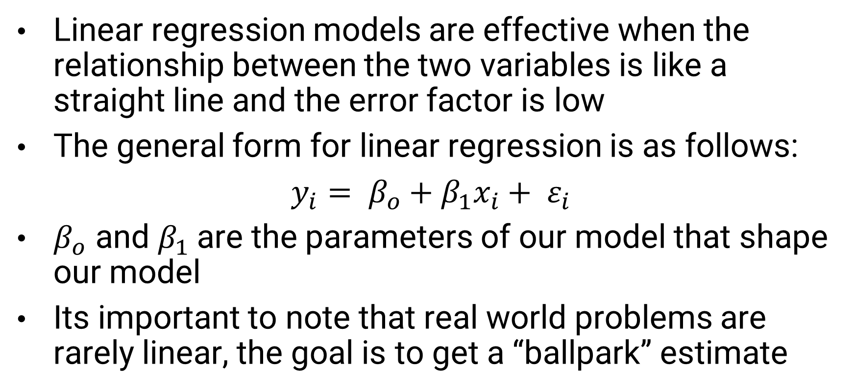
Linear Regression
Linear regression models are effective when the relationship between the two variables is like a straight line and the error factor is low
The general form for linear regression is as follows:
$y_{i}= β_{o}+β_{1}x_{i}+ ε_{i}$
$β_{o}$ and $β_{1}$are the parameters of our model that shape our model
Its important to note that real world problems are rarely linear, the goal is to get a “ballpark” estimate

Slide 10
Evaluating Regression Models
Recall that the correlation coefficient measures the degree of the linear relationship between 2 variables
However, it does not describe the exact relationship between the variables, this is where regression comes in
If we look at some plotted data, it is easy to see there are many possible models that could describe our data
We need some way of determining the optimal model for our data

Slide 11
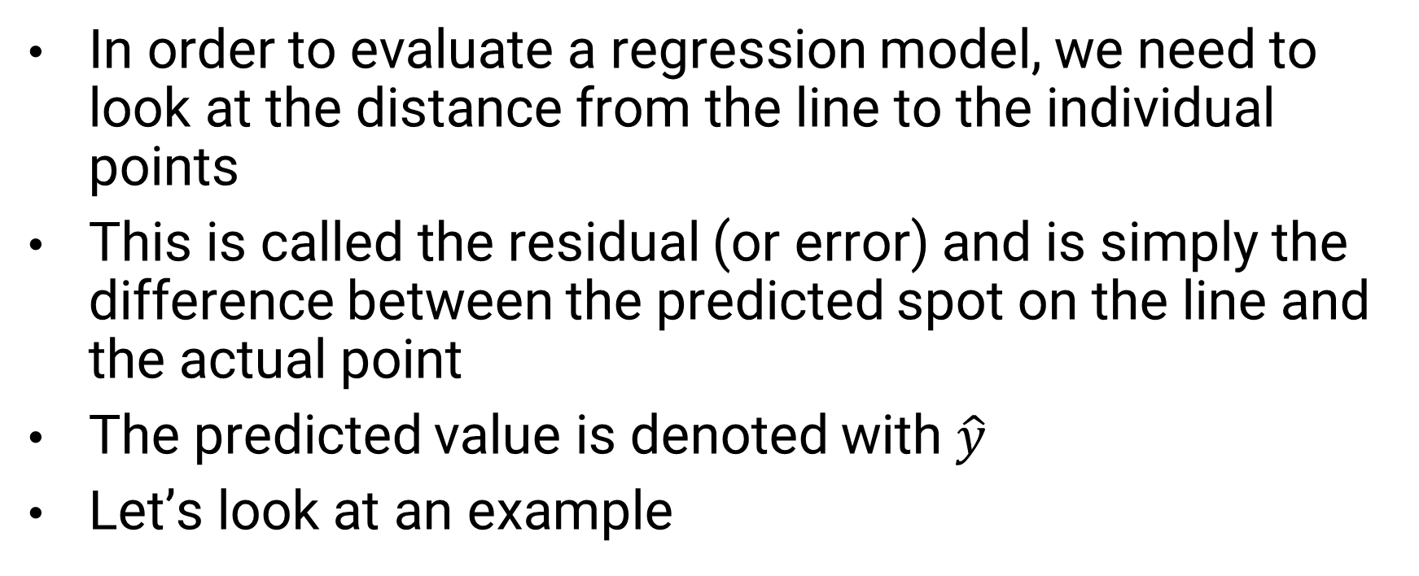
Evaluating Regression Models
In order to evaluate a regression model, we need to look at the distance from the line to the individual points
This is called the residual (or error) and is simply the difference between the predicted spot on the line and the actual point
The predicted value is denoted with $\hat{y}$
Let’s look at an example

Slide 12
Example
As you can see, there is not a single line that goes through all the points, so we will need to estimate one

Slide 13
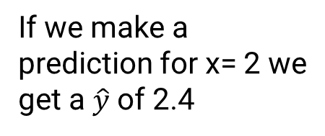
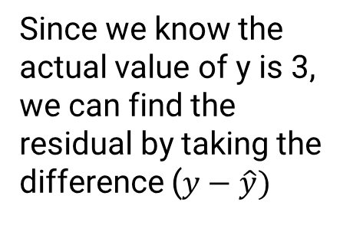
Example
We will assume a good regression model is y= 0.7x +1
If we make a prediction for x= 2 we get a $\hat{y}$ of 2.4
Since we know the actual value of y is 3, we can find the residual by taking the difference ($y−\hat{y})$

Slide 14
Sum of Square Errors (SSE)
Now we can repeat the process for the remaining points in our graph
It might be tempting to sum all the residuals and choose the model with the least amount, but there is an issue
Our residuals can be negative or positive, so its possible our residuals would start canceling each other out

Slide 15
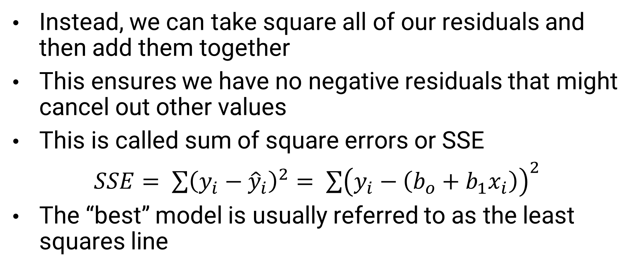
Sum of Square Errors (SSE)
Instead, we can take square all of our residuals and then add them together
This ensures we have no negative residuals that might cancel out other values
This is called sum of square errors or SSE
$SSE= \sum{{\left(y_{i}−{\hat{y}}_{i}\right)}^{2}= \sum{{\left(y_{i}−\left(b_{o}+b_{1}x_{i}\right)\right)}^{2}}}$
The “best” model is usually referred to as the least squares line

Slide 16
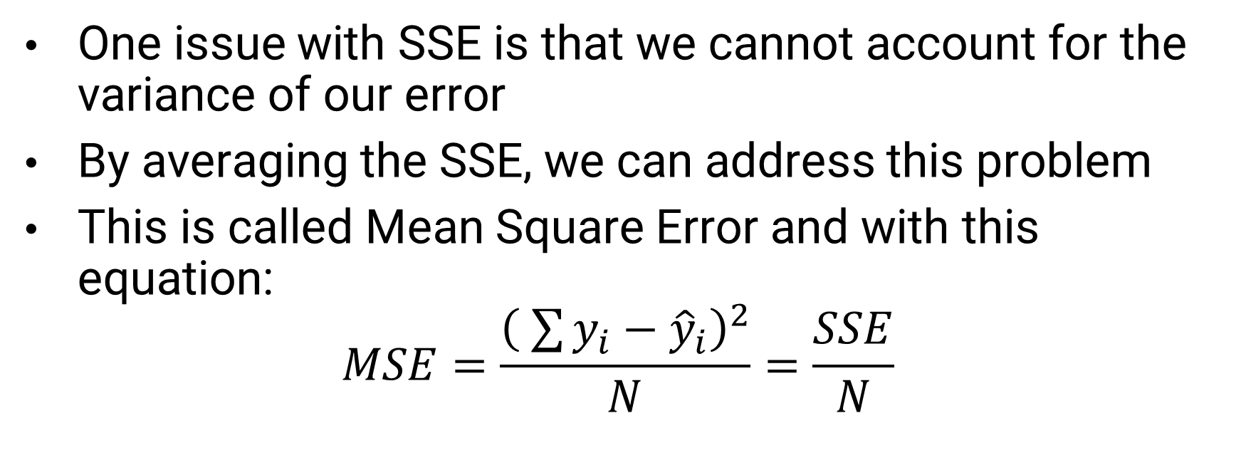
Mean Squared Error (MSE)
One issue with SSE is that we cannot account for the variance of our error
By averaging the SSE, we can address this problem
This is called Mean Square Error and with this equation:
$$MSE=\frac{{\left( \sum{y_{i}}−{\hat{y}}_{i}\right)}^{2}}{N}=\frac{SSE}{N}$$

Slide 17
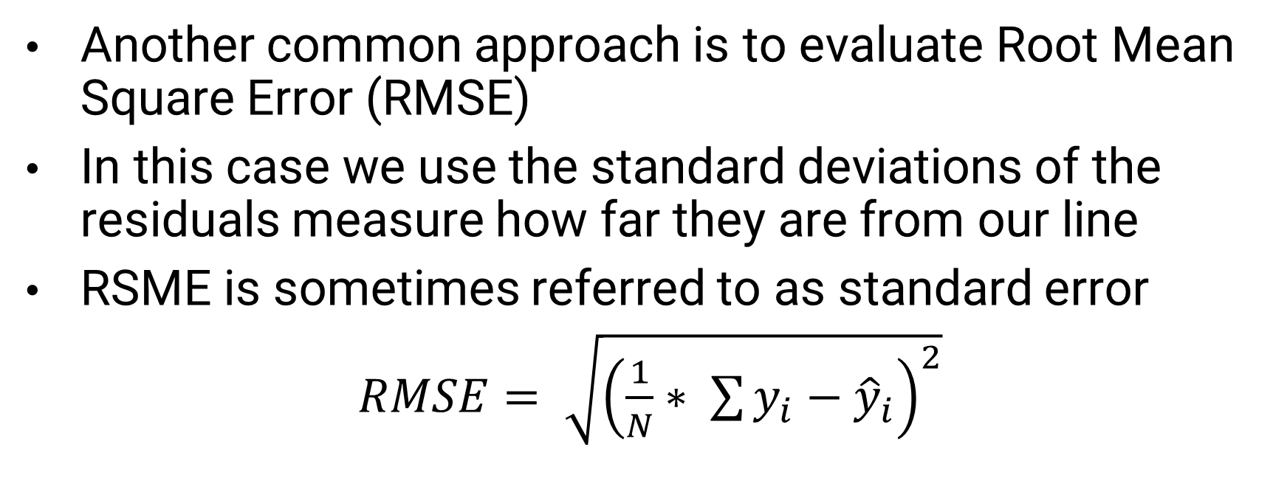
Root Mean Square Error (RMSE)
Another common approach is to evaluate Root Mean Square Error (RMSE)
In this case we use the standard deviations of the residuals measure how far they are from our line
RSME is sometimes referred to as standard error
$RMSE= \sqrt{{\left(\frac{1}{N}∗ \sum{y_{i}}−{\hat{y}}_{i}\right)}^{2}}$

Slide 18
Developing a Linear Regression Model
Like correlation most statistics software comes well equipped to calculate a linear regression model
We can also use the Scipy Python package to calculate our linear regression model
Let’s do an example using Python

Slide 19
Final Thoughts on Regression
We have only begun to scratch the surface of regression
There are several types of regression and several ways to evaluate models
Regression models are a staple of machine learning and we re-visit this topic very soon
Remember if we want to predict a specific value of something, we likely are going to make use of regression in some way

Slide 20
Next Time
Begin Discussing Machine Learning
Remember no class on Monday 02/20
Homework 4 will be due on 02/22
Homework 5 will be assigned next class

